Slide 1





Serverless Deep Neural Network with Azure Functions and ML.Net
ANZ 2020
Thanks to our sponsors

Slide 2




Introduction
Cloud Architect @
Domain: Professional Audio, Video & Control
Area of Expertise: Cloud, Distributed computing
Area of Interest: AI/ML, Cloud and IoT
Location: Bangalore, India
Member:

Slide 3
Agenda
Deep Neural Network
Serverless
Azure Functions
ML.Net
Demo

Slide 4
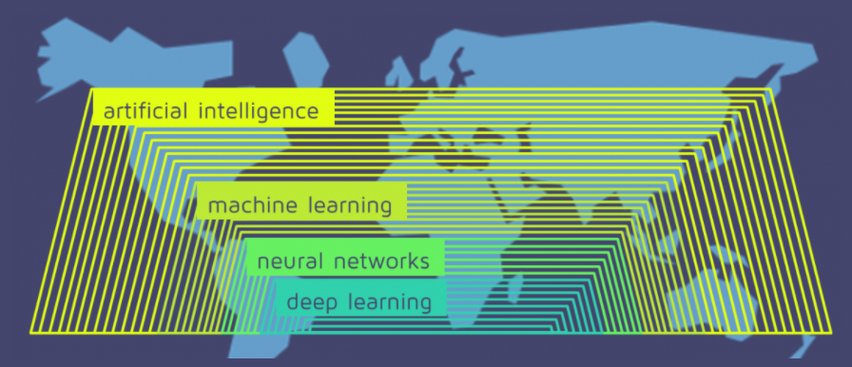
Deep Neural Network
source: https://quantdare.com/what-is-the-difference-between-deep-learning-and-machine-learning/
Notes:
AI involves a computer executing a task a human could do.
Machine learning involves the computer learning from its experience and making decisions based on the information.

Slide 5
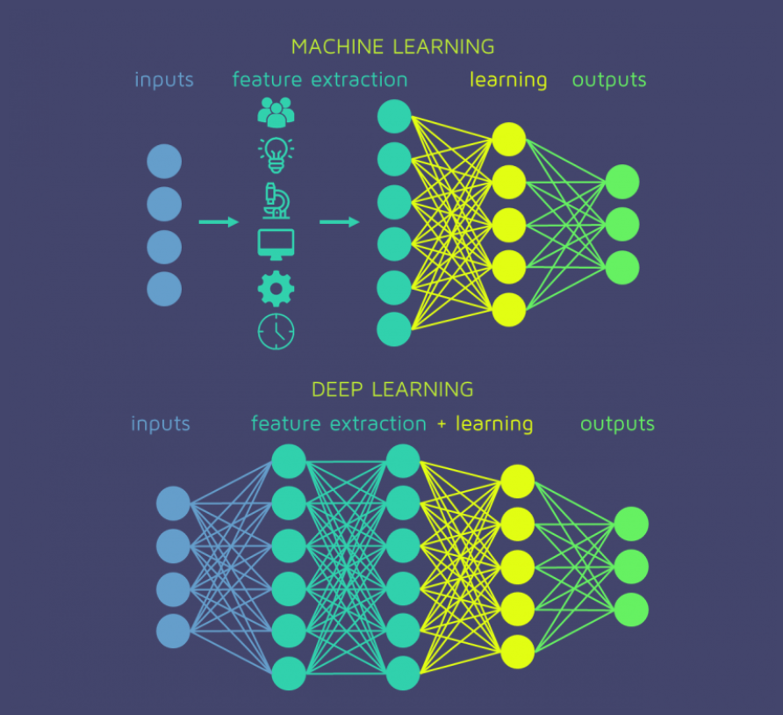
Deep Neural Network
source: https://quantdare.com/what-is-the-difference-between-deep-learning-and-machine-learning/

Slide 6
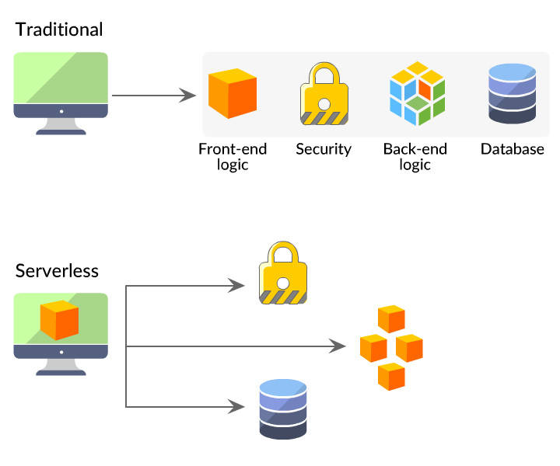
Serverless
source: https://danielhkim.net/2020/02/27/serverless-cloud-computing/

Slide 7
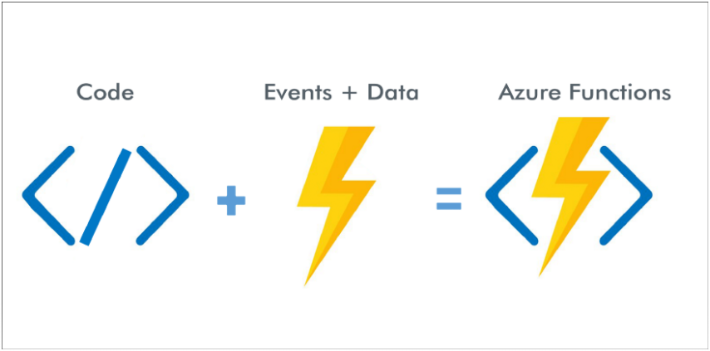
Azure Functions

Slide 8
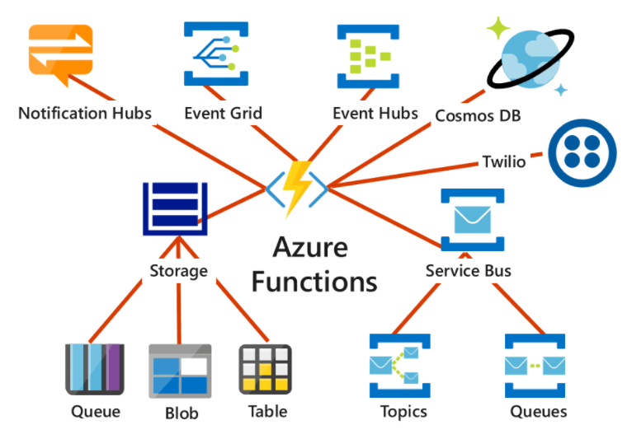
Azure Functions

Slide 9
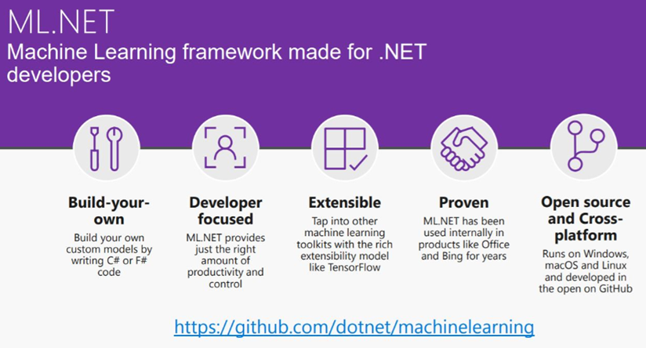
ML.Net

Slide 10
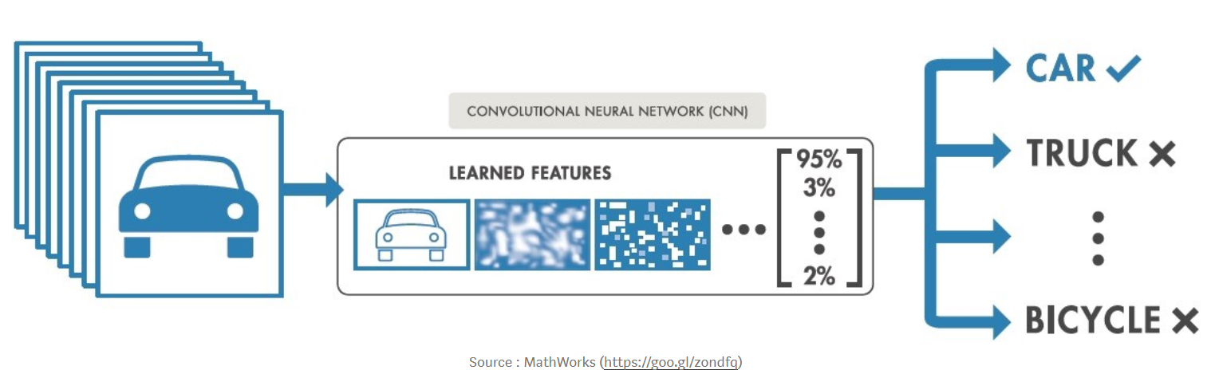
Image Classification

Slide 11
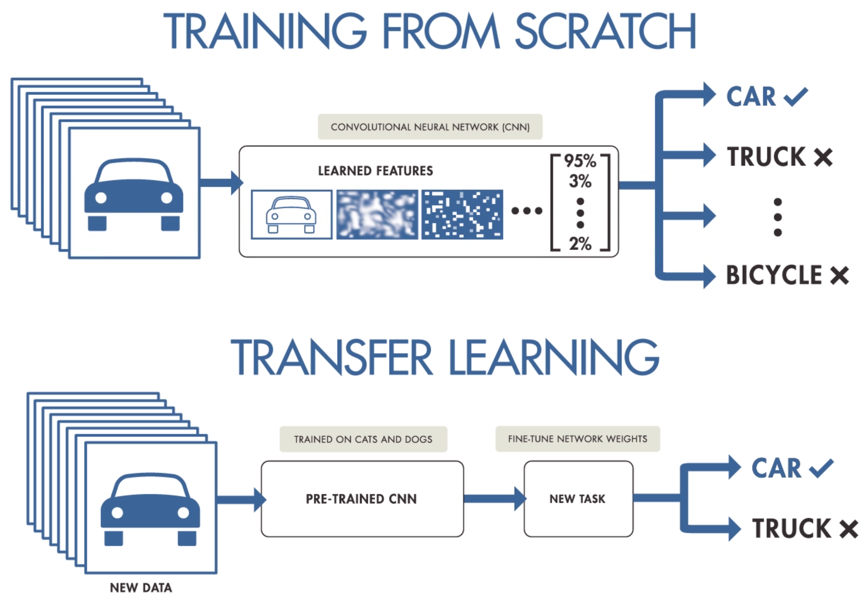
Transfer Learning – MobileNet V2
source: https://i.pinimg.com/originals/0a/76/eb/0a76eb3c95c249cdff9449af08ac4efc.png

Slide 12
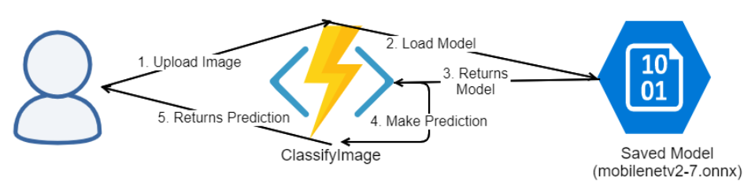
Cloud Architecture

Slide 13
Create a Azure Function App
Save MobileNetV2 model to Azure Storage Blob
Create ClassifyImage API
Load model in Azure Function
Make Prediction
Test through Postman – Locally
Deploy to Azure Functions on Cloud.
Demo

Slide 14

Customer Success Stories – ML.Net
https://dotnet.microsoft.com/apps/machinelearning-ai/ml-dotnet/customers

Slide 15
Resources
Github: https://github.com/praveenraghuvanshi/tech-sessions/tree/master/04092020-ServerlessDays-ANZ-2020

Slide 16
References
https://docs.microsoft.com/en-us/azure/azure-functions/functions-develop-vs
https://blog.rasmustc.com/multipart-data-with-azure-functions-httptriggers/
https://docs.microsoft.com/en-us/dotnet/machine-learning/tutorials/image-classification
https://docs.microsoft.com/en-us/samples/dotnet/machinelearning-samples/mlnet-image-classification-transfer-learning/
https://docs.microsoft.com/en-us/dotnet/machine-learning/tutorials/object-detection-onnx

Slide 17





Thank you Q & A
https://in.linkedin.com/in/praveenraghuvanshi
https://github.com/praveenraghuvanshi
@praveenraghuvan
https://t.me/joinchat/IifUJQ_PuYT757Turx-nLg

